Slide 1
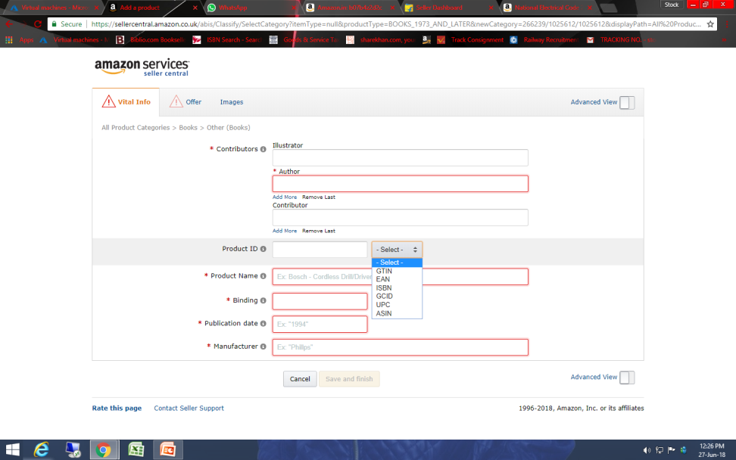
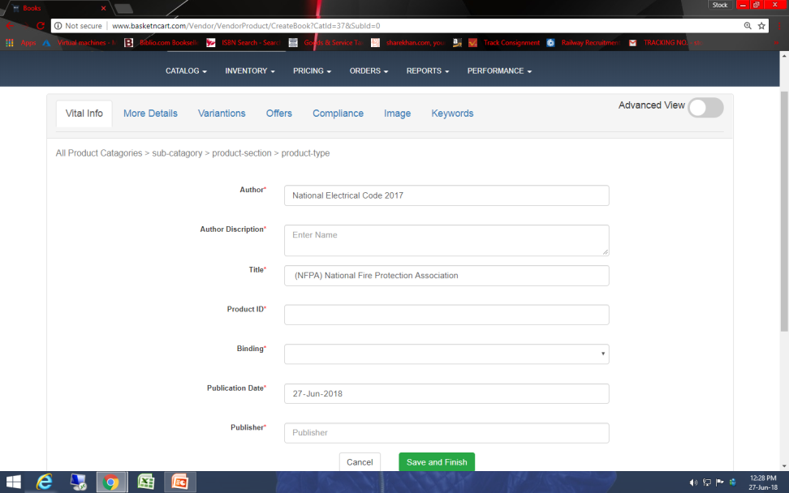
74. There is no option to select Product id type.
Amazon
Basketncart

Slide 2
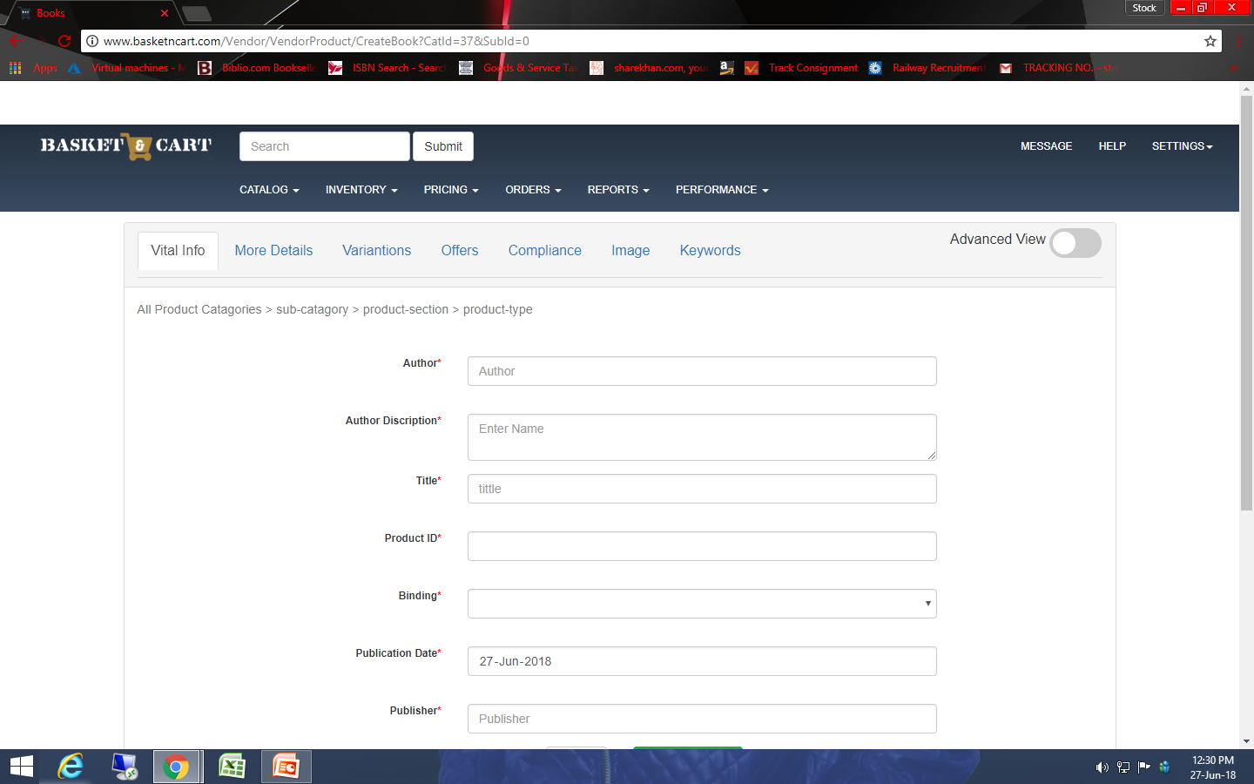
75. Coloum is auto blacked while changing page.

Slide 3
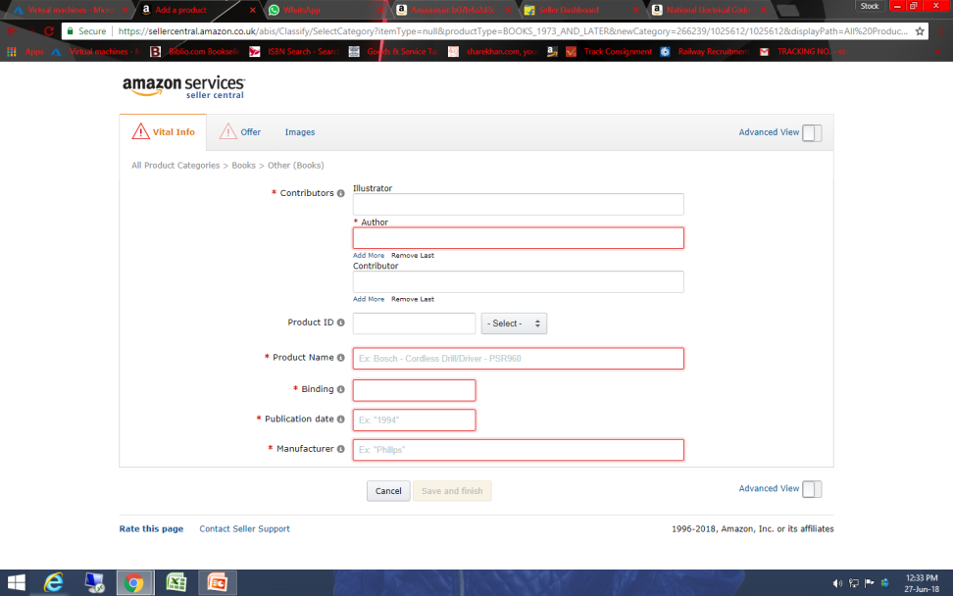
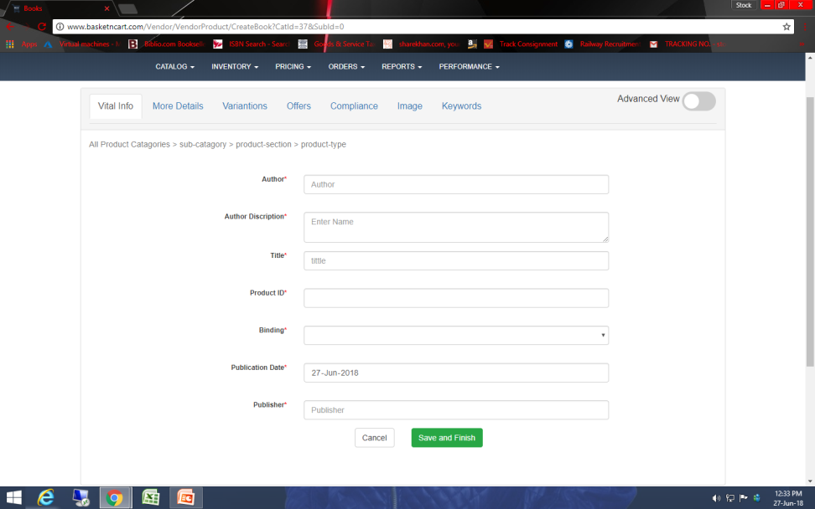
76. Save option is just shown when all important coloum is filled up.
Amazon
Basketncart

Slide 4
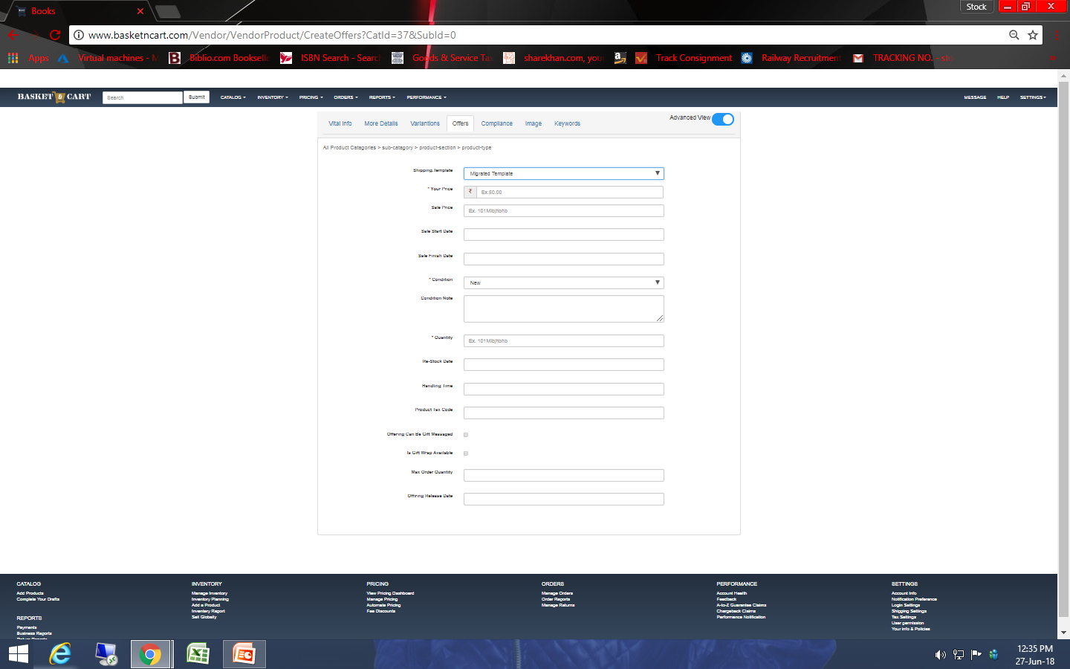
79. There is no option to save the product.

Slide 5
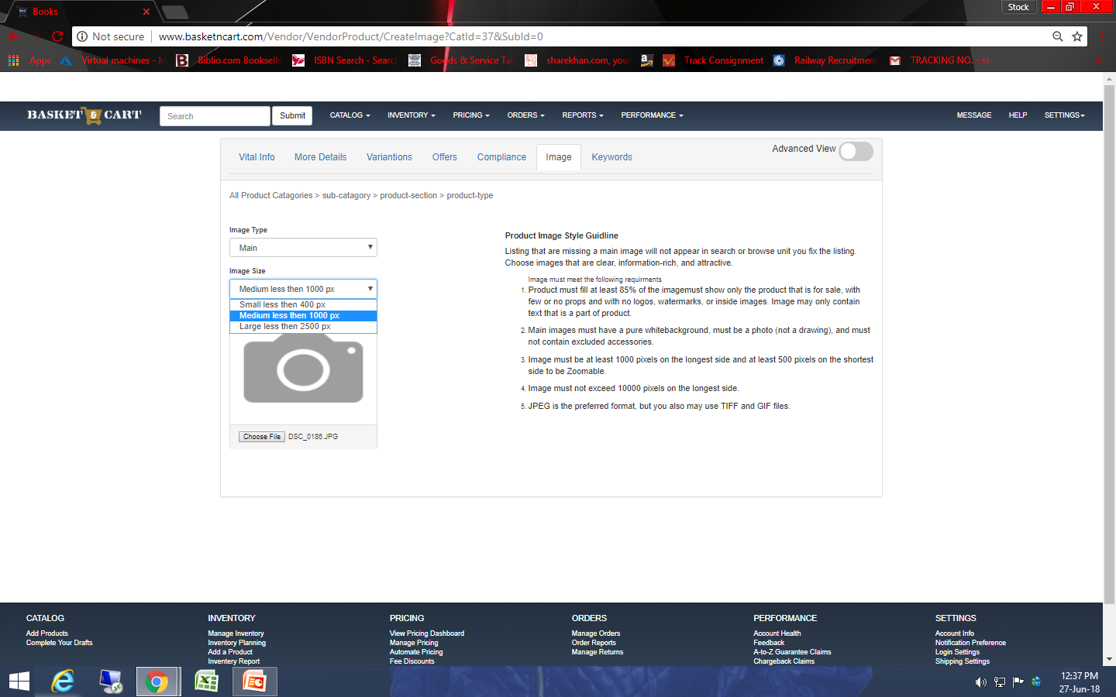
80. Image must have minimum 1000 pixels to upload.

Slide 6
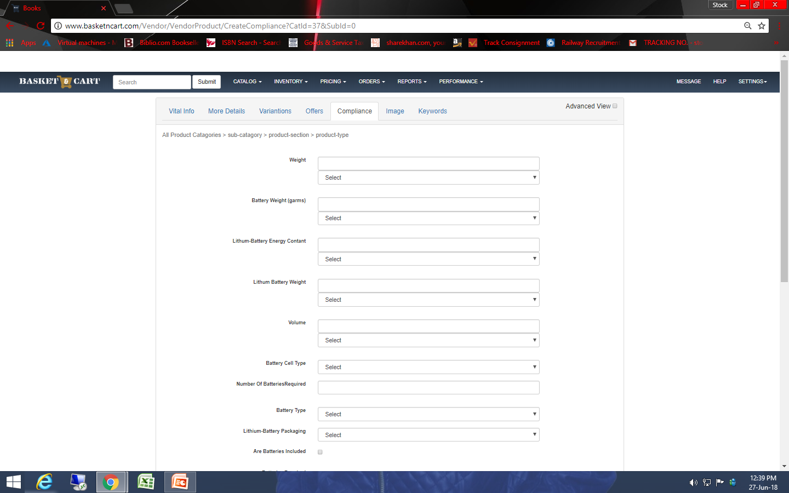
81. Advance view logo is still chinging.

Slide 7
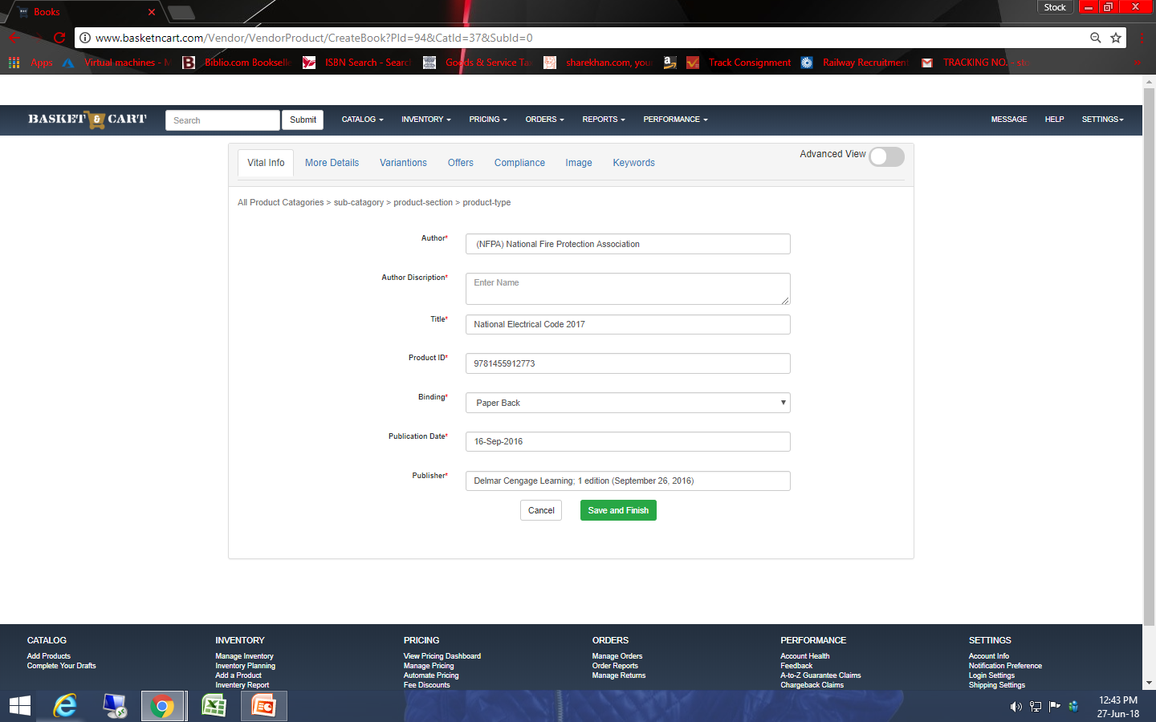
82. Save button should not be worked until all red star coloum is filled.

Slide 8
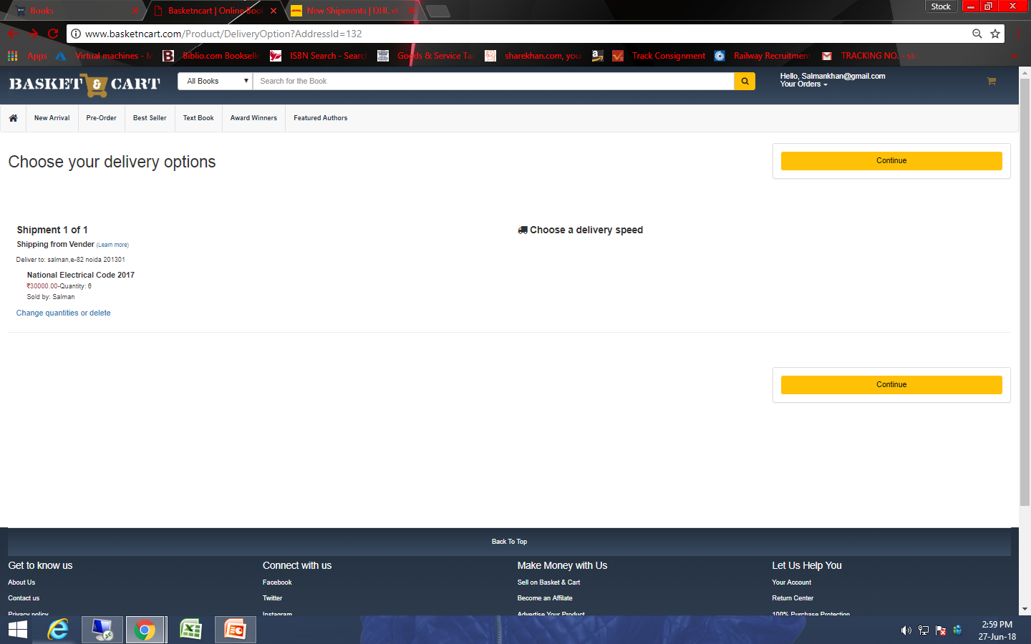
83. Servre error is coming ahead of this page.

Slide 9
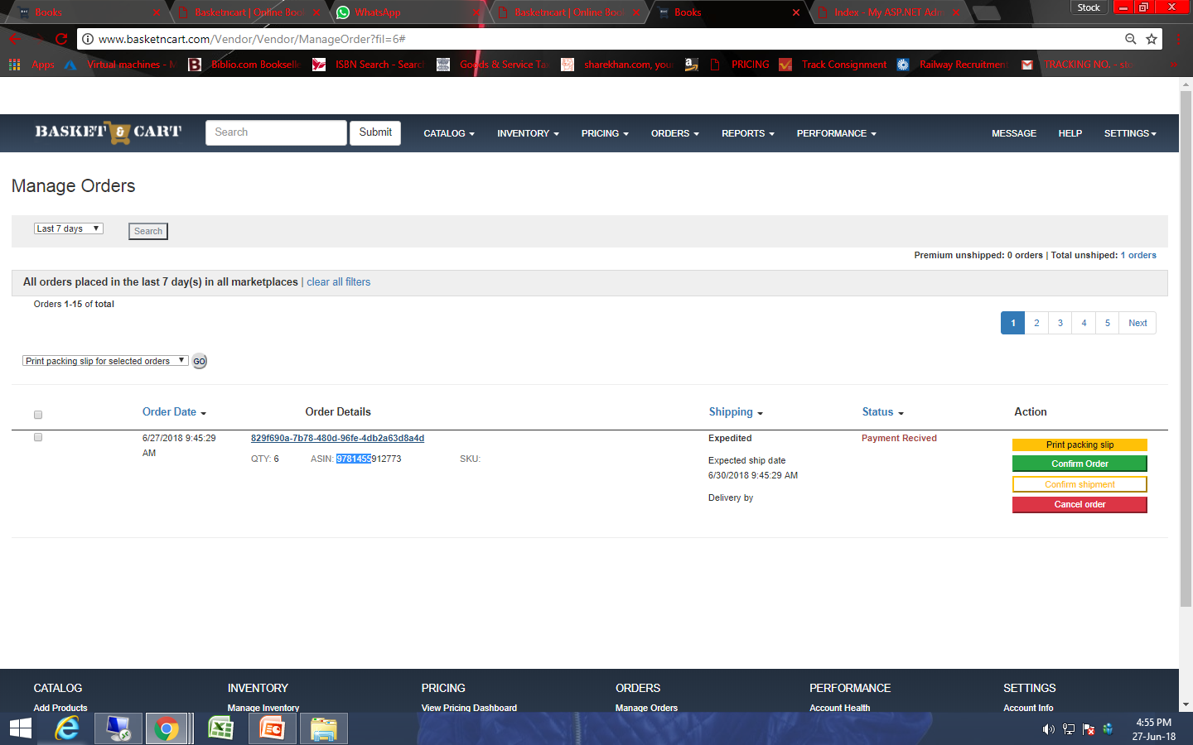
84. Order id link not woking

Slide 10
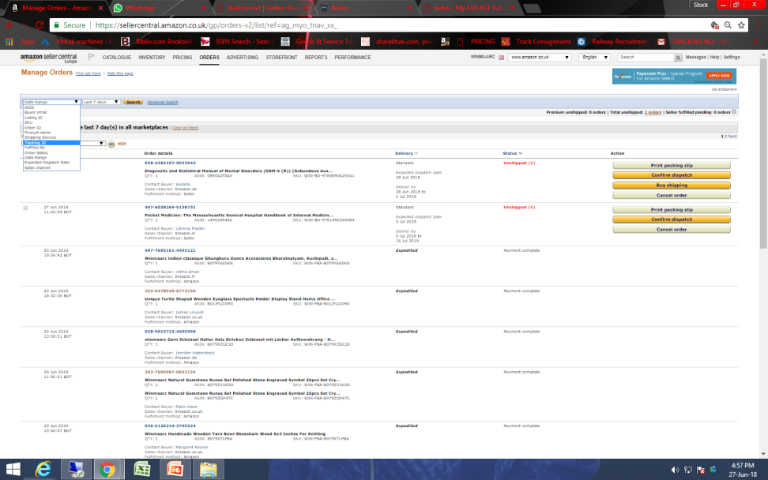
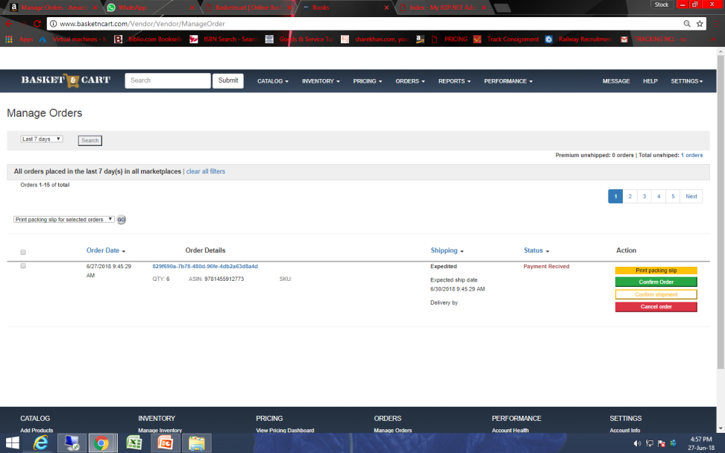
85. There is not option to filter
Amazon
Basketncart

Slide 11
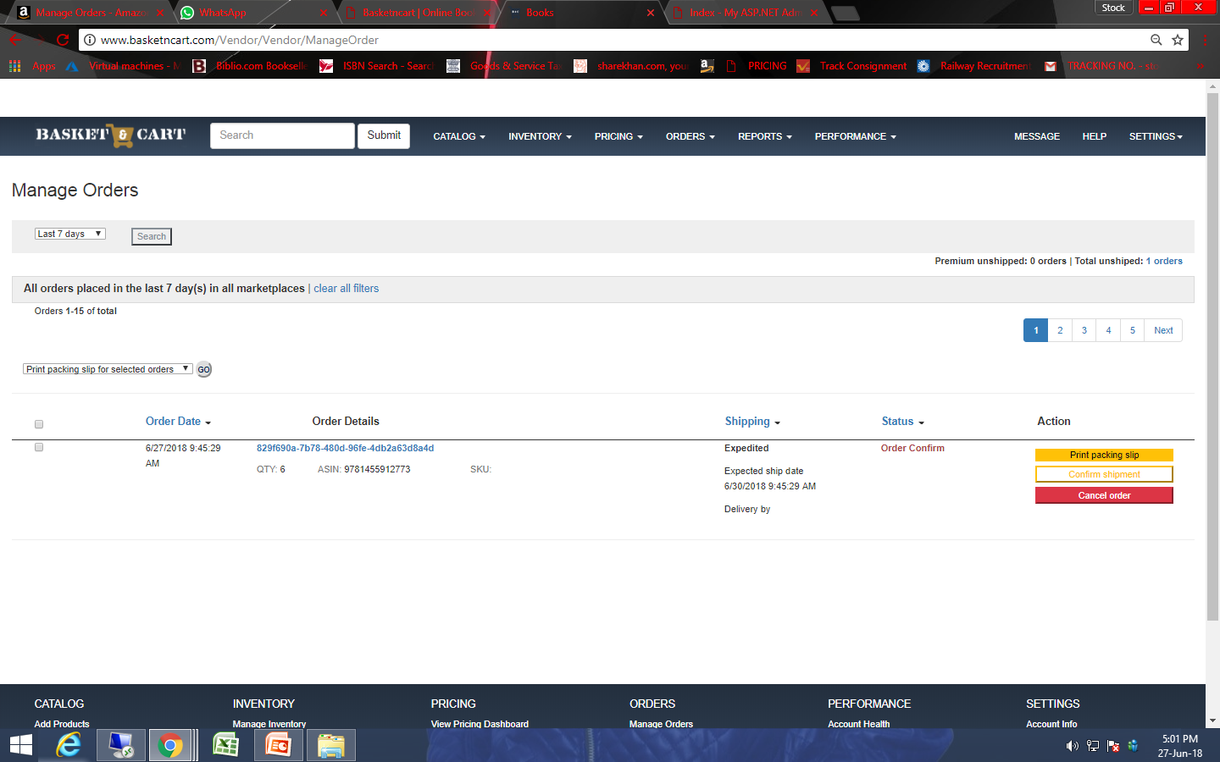
86. There is showing order confirm option after confirm the order.

Slide 12
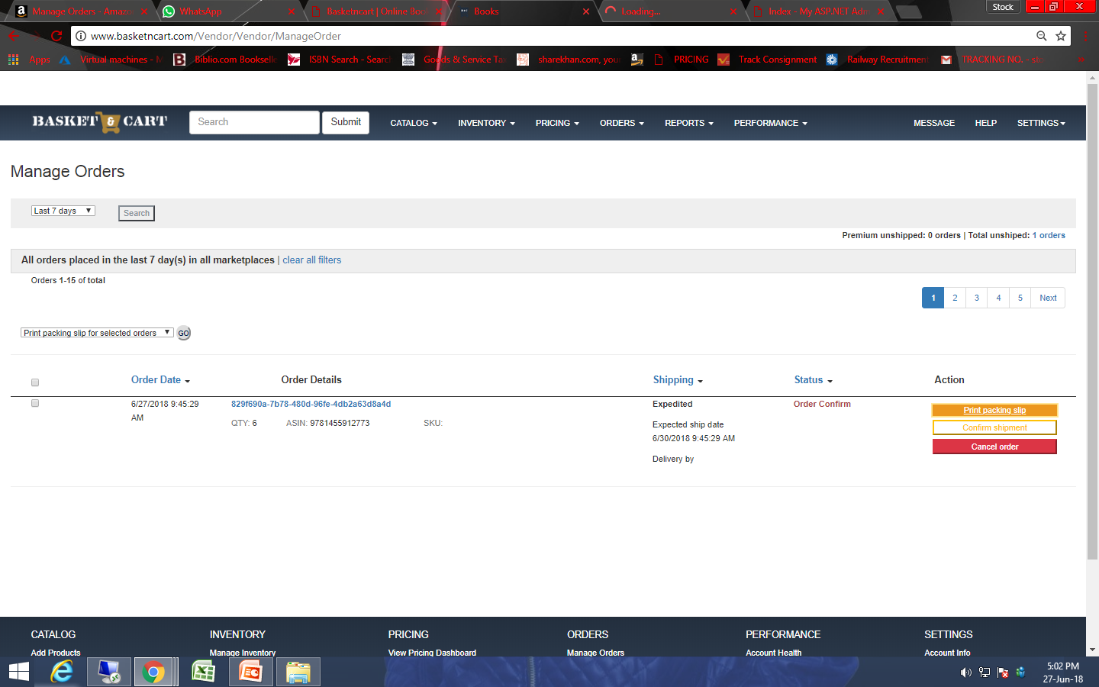
87. There is cancel order option is not working.

Slide 13
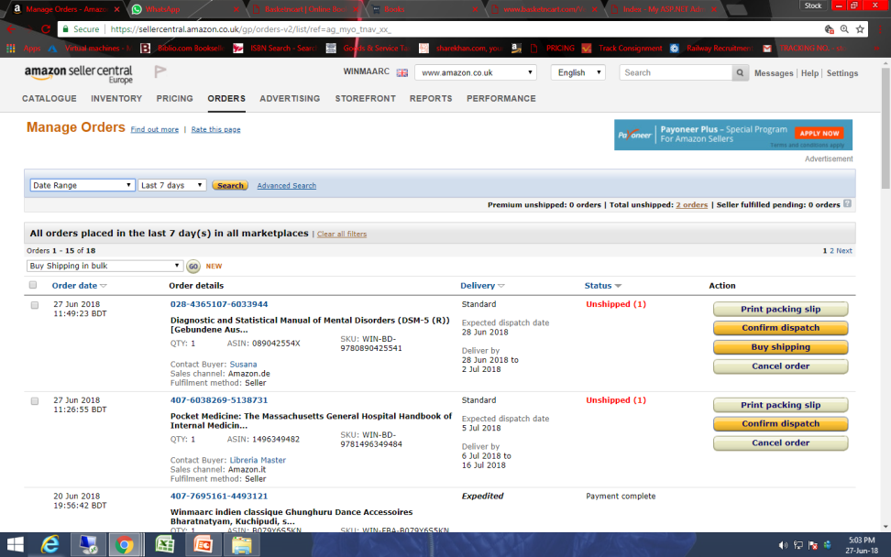

88. There is not showing title of the item.
Amazon
Basketncart

Slide 14

89. Order ID option is not working.

Slide 15

90. Order id comes with just 7-9 numerical words.

Slide 16


91. There is not option to see pending option.
Amazon
Basketncart

Slide 17

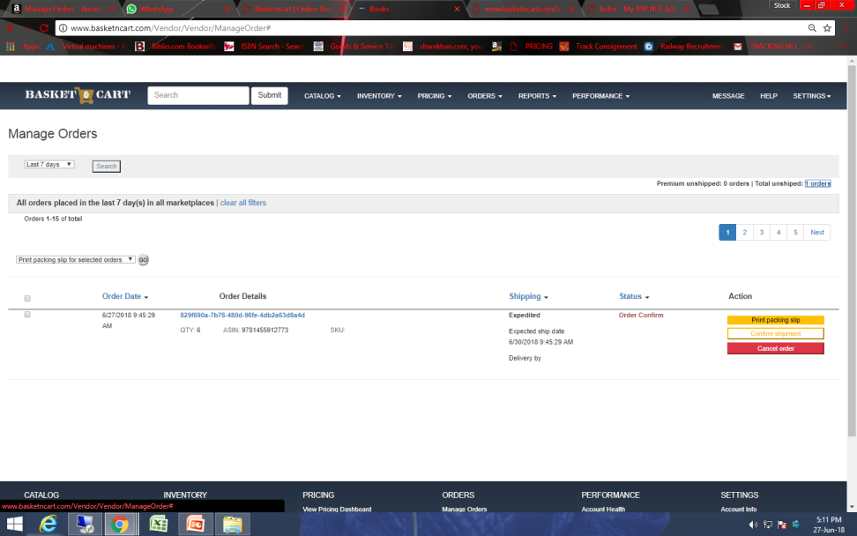
92. There is not option coming to buyer name or futher detail and buyer name is linked which open message page.
Amazon
Basketncart

Slide 18


93. There is not showing delivery time.
Amazon
Basketncart

Slide 19
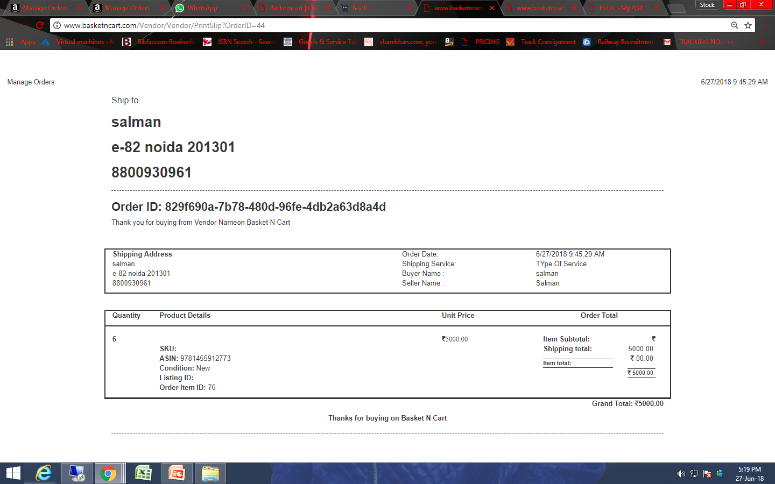
94. Our Invoice should have Delivery by date.

Slide 20
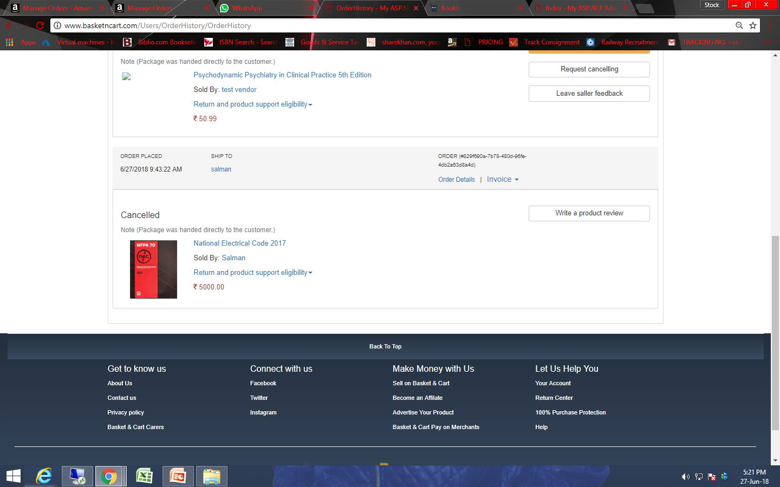
95. There is product review option is not working.

Slide 21
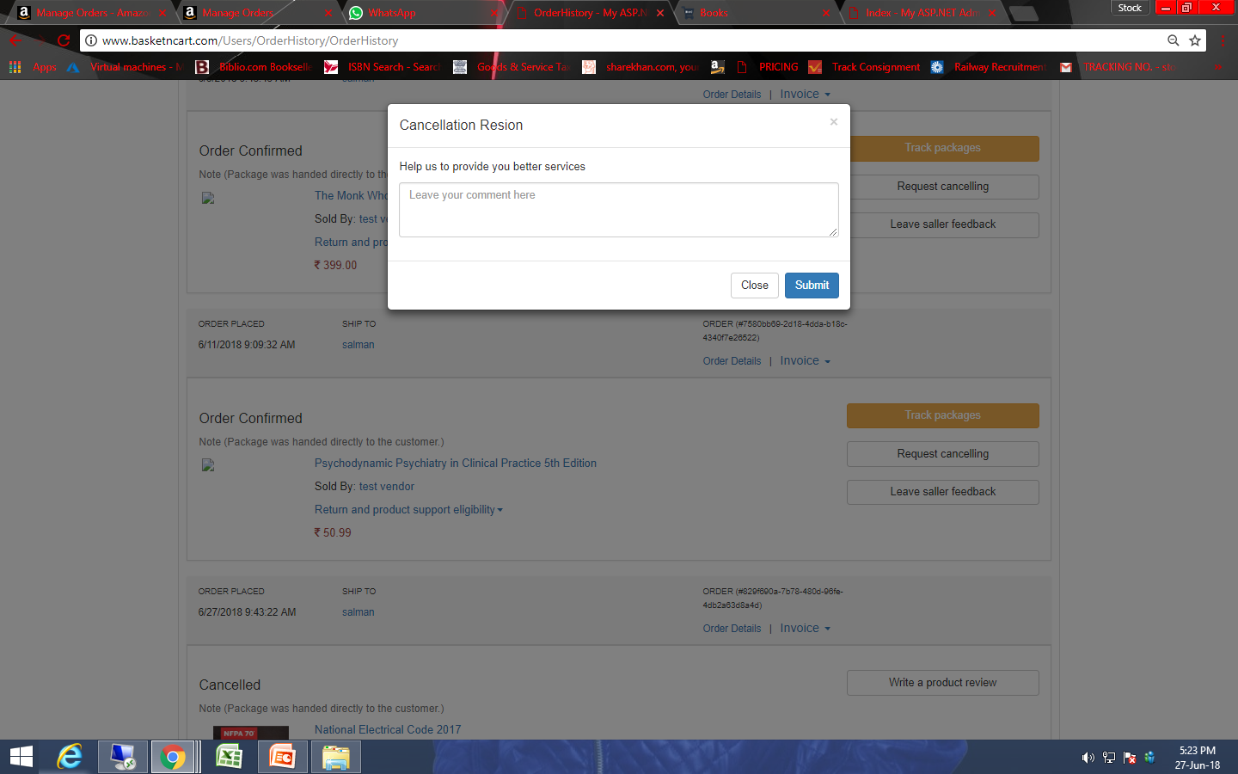
96. There is no option to select while cancel the order.

Slide 22
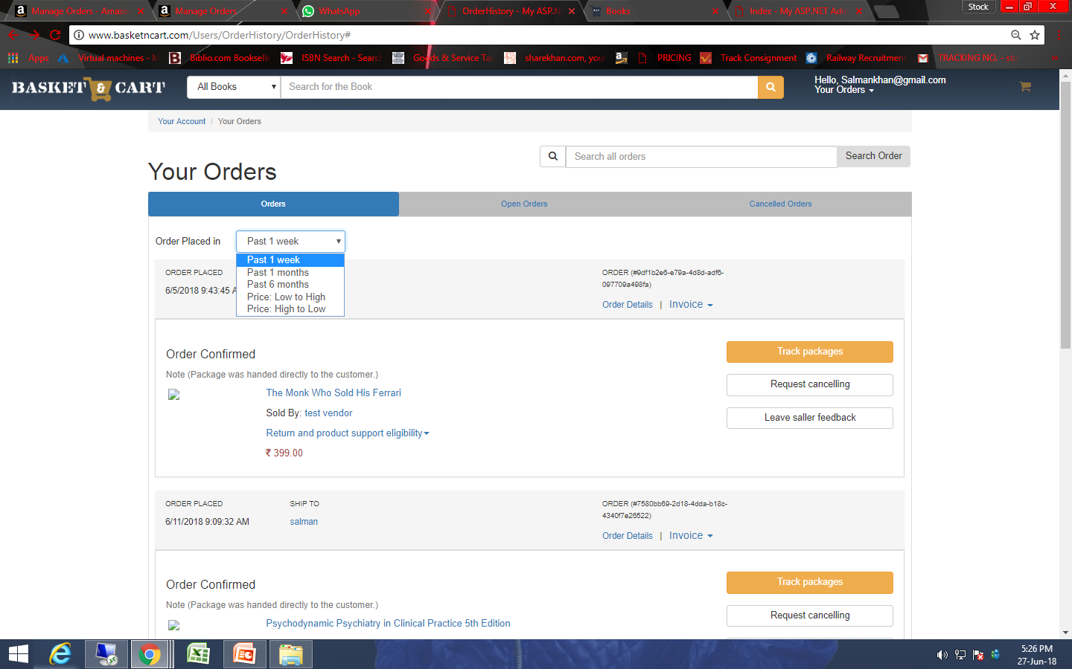
97. Option is not working.

Slide 23
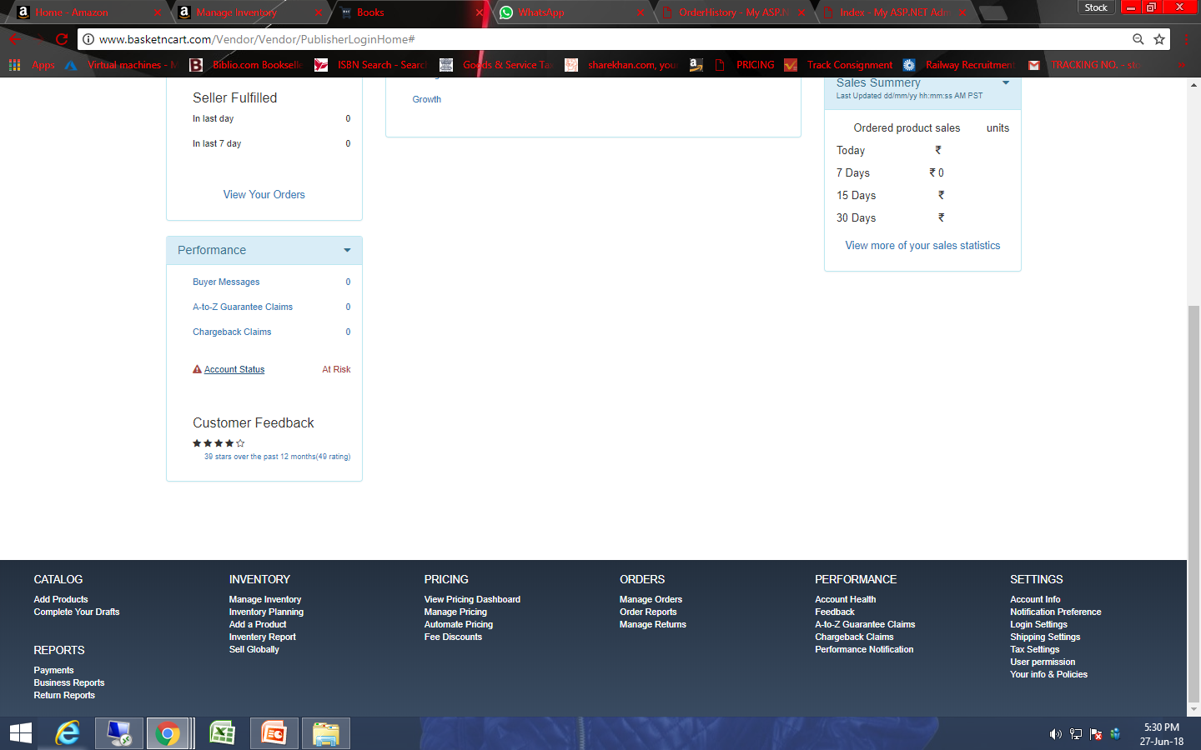
98. Links are not working.

Slide 24
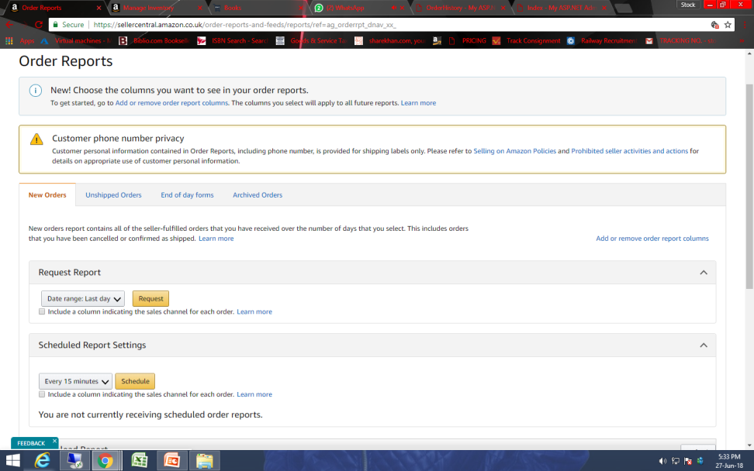
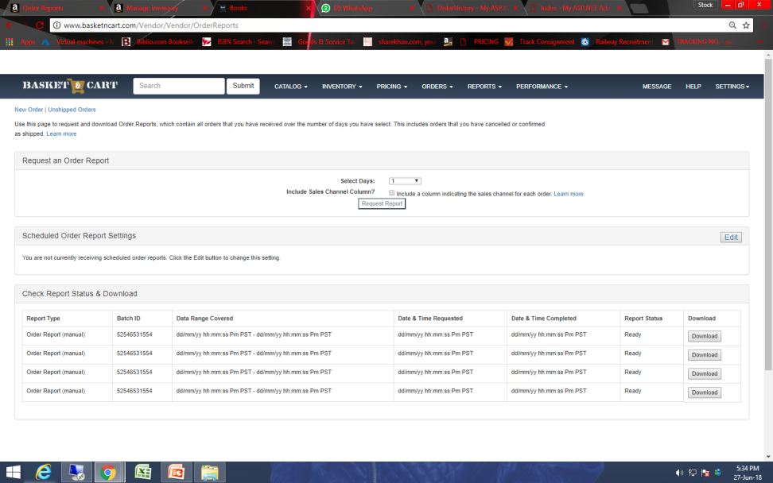
99. There is not option to download different files.
Amazon
Basketncart

Slide 25
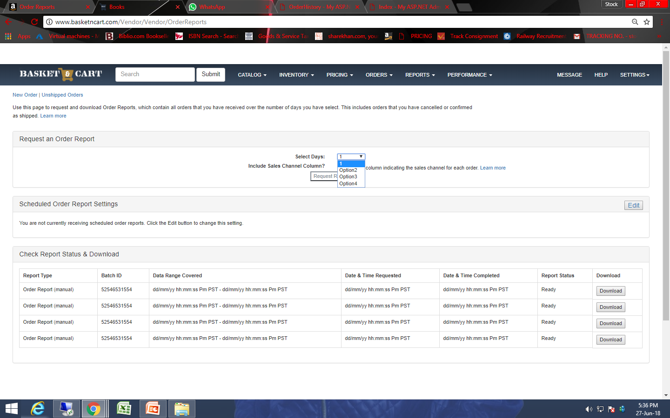
100. There is not option to select days.

